Slide 1










Dream of Job in Korea,
Woosong will open it for you
가
나
다
2025 Global Talent Employment Leading University,
Woosong University

Slide 2


Woosong University
Global Talent Employment Leading University Guide
Global Talent Training Program
- PART 1. Foundational Program
- PART 2. Advanced Program
K-WORK User Guide
Introduction to Woosong University Employment Support Center
CONTENTS

Slide 3







Global Talent Employment Program Guide
Curriculum Configuration (Phase 1)
Curriculum
Configuration (Step 2)
Understanding companies
and employment
Corporate Cooperation Practice
Corporate Linked Capstone Design,
Project-based learning
Understanding SME businesses,
resume/self-introduction writing, interview
Job and Practical Skills
Professional Training
Labor Standards Act. Industrial Safety Education, Business Korean (Advanced)
Understanding Jobs by Industry
Data Analysis Practice
Language &
Career Readiness
Career readiness
Internship matching, portfolio creation, interview feedback
Korean Intermediate Education, Career Camp
Visa Settlement
Employment Support
K-Work Careers
Matching System
AI Recommender System
Visa Consulting
+30% Matching Accuracy
D-10/E-7 Visa Conversion Consulting
Corporate Network
Settlement Support
Connecting 100 companies
Legal, financial, and life services
Recruitment Performance
70% conversion rate for graduates
Induce long-term service
Improve adaptation
Induce employment for more than
2 years after employment
Korean Workplace Culture Education
Customized matching between
n companies and talents

Slide 4
Global Talent Employment Training
PART 1. Foundational Program
Common Competencies
Employability
Job competencies
Other

Slide 5
PART 1. Foundational Program
Joint Capabilities | ① Korean Language Education
Business Overview | Checking the level through basic Korean language assessment and learning real-life Korean to support adaptation to Korean society and work life.
Project Period | 2025. 5. ~ 2025. 6. | No. of Educators | 80
Contents | ⦁Basic Korean Language Assessment ⦁Greeting Practice ⦁Introduce yourself ⦁Continue daily conversations ⦁Responding to numbers and finance ⦁Restaurant and Commerce related Korean ⦁How to use transportation ⦁Commerce high-level language ⦁How to deal with emergencies ⦁Meetings, moving days, work-related expressions ⦁Role-play and presentation using what you have learned
Procedure | Basic Korean Assessment > Daily Conversation and Real Life Korean Education > Role-play and presentation using what you have learned
Woosong University

Slide 6
PART 1. Foundational Program
Employability | ① Understanding Small and Medium Business
Business Overview | Understand the overall structure of the Korean economy by learning the definition and economic role of SMEs, market structure competition strategies, and government support systems.
Project Period | 2025. 6. | Number of Educators | 80
Contents | ⦁Definition, characteristics, and economic role of SMEs ⦁market structure, competitive strategy & government support systems ⦁Marketing, H/R Management, Financial Management Fundamentals ⦁Innovation and technology development, global market entry strategy ⦁Practical case studies and discussions, practical application workshops
Procedure | Understanding the concept of SMEs > analyzing industry structure > learning key management functions > Case-based practice
Employability | ② Resume and cover letter writing practice
Business Overview | Resume & cover letter basic structure and writing tips education to acquire competencies tailored to the Korean job market.
Project Period | 2025. 7. | Number of Educators | 80
Contents | ⦁Resume and cover letter overview & Basic Understanding ⦁Customized writing strategies for each job ⦁Resume drafting practice ⦁Practice in drafting a personal statement ⦁Feedback and final completion
Procedure | Resume and cover letter outline, item comprehension > writing strategy learning and practice > feedback and final completion
Woosong University

Slide 7
PART 1. Foundational Program
Employability | ③ Mock interviews and coaching
Business Overview | Understanding various interview types of Korean companies, coaching on strategic response capabilities for each actual interview situation.
Project Period | 2025. 07. | Number of Educators | 80
Contents | ⦁Understand interview types (1:1, group, AI interviews) in Korean companies ⦁Effective answer strategies for each interview question ⦁Individual interview practice and feedback ⦁Coaching for corporate executives and expert interviews ⦁Analysis of actual corporate interview cases and response strategies
Procedure | Understanding interview types > establishing interview response strategies > practice and feedback > expert coaching > Analyzing actual cases and establishing response strategies
Woosong University

Slide 8
PART 1. Foundational Program
Job competencies | ① Data Analysis Practical Training (Python Skill 1)
Business Overview | Learning Python structure and basic grammar to lay the foundation for practical job competencies.
Project Period | 2025. 8. | Number of Educators | 40
Contents | ⦁Pyton environment building and basic grammar, examples & review lectures ⦁Key data structures in Pyton ⦁Deepening control statements ⦁ Understanding, practice and review of functions and modules ⦁Data Processing Basics ⦁Leverage Pandas and Numpy ⦁Project planning and implementation ⦁Code review and optimization ⦁Project presentation preparation, project presentation and feedback
Procedure | Python Fundamentals > Data Processing Practice > Project Design and Implementation > Presentation and Feedback
Job competencies | ② Understanding of industry and job
Business Overview | Establishment of a personalized employment plan through job introductions for major industries in Korea and the required competencies & aptitude tests.
Project Period | 2025. 08 | Number of Educators | 80
Contents | ⦁Job Introduction and Prospects for Major Industries in Korea ⦁Required competencies and job aptitude test for each job ⦁Analysis of recruitment process & strategy establishment for each company ⦁Create a customized employment roadmap for your desired job ⦁Employment Success Stories and Mentoring Sessions
Procedure | Understanding jobs and prospects for each major industry> Establishing a recruitment strategy > competency and aptitude test> Creating a customized roadmap > Mentoring based on actual cases
Woosong University

Slide 9
PART 1. Foundational Program
Others | ① Data Analysis Practical Training (Python Skill 2)
Business Overview | Understand the basics of data analysis, and strengthen practical skills by learning how to collect and preprocess data.
Project Period | 2025. 8. | Number of Educators | 40
Contents | ⦁Data Analysis Basics ⦁Data collection ⦁Data preprocessing ⦁Data visualization ⦁Projects & Presentations
Procedure | Data Analysis Practical Training > Projects and Presentations
Woosong University

Slide 10
PART 1. Foundational Program
Global Talent Employment Training
PART 2. Advanced Program
Other
Employment Practice
Employment Training
Common Competencies
Employability
Job competencies
Other

Slide 11
PART 2. Advanced Program
Others | ① Business Korean Education
Business Overview | Enhance job expertise by strengthening business Korean skills that are essential for job performance.
Project Period | 2025. 09. ~ 10. | Number of Educators | 80
Contents | ⦁Learning work-related business terms and expressions ⦁How to understand and write contracts and official documents ⦁Writing and presenting practical reports ⦁Customer and phone response skills ⦁Practice business Korean based on real cases
Procedure | Learn Nice terms and expressions > Improve business document writing skills > strengthen communication skills > practice practical application
Woosong University

Slide 12
PART 2. Advanced Program
Employment Practice | ① Industry-University Cooperation Project Company-linked Capstone Design
Business Overview | Strengthening planning capabilities through team project task solving and presentation.
Project Period | 2025. 10. ~ 11. | Number of Educators | 30
Contents | ⦁Preliminary consultation on joint research projects with companies (professor in charge) ⦁Orientation, team composition, and task selection for each team ⦁Task progress, planning establishment (goal setting, division of work) ⦁Task progress data by team, prototype research ⦁Design and development progress ⦁Prototype development, presentation ⦁Design and development progress ⦁Final development and functional improvement ⦁Report writing, PPT writing
Procedure | Preparation of corporate joint tasks > team project progress > results presentation
Employment Practice | ② Data Analysis (Python Project)
Business Overview | Strengthening practical employment capabilities through data analysis projects.
Project Period | 2025. 12. ~ 2026. 01. | Number of Educators | 40
Contents | ⦁ Project topic selection, planning ⦁ Data Collection/Model Development ⦁ Service Implementation and Deployment ⦁ Portfolio Creation, Documentation ⦁ Teamwork and collaboration skills
Procedure | Data analysis project assignment > portfolio creation Empowering > collaboration
Woosong University

Slide 13
PART 2. Advanced Program
Employment Training | ① Labor Standards Act ⦁ Industrial Safety Education
Business Overview | Based on an understanding of Korean labor laws and working environment, we provide practical education to help them find a stable job and adapt to the workplace.
Project Period | 2026. 01. | Number of Educators | 80
Contents | ⦁ Korean Labor Standards Act and Protection of Foreign Workers ⦁ Sexual harassment prevention education & legal response in the workplace ⦁ Occupational Safety/Risk Management ⦁ Review of employment contract ⦁ Industrial Relations and Employment Insurance
Procedure | Learning about the Labor Standards Act and Industrial Safety Regulations > Understanding of Employment Contracts > Understanding of Industrial Relations and Employment Insurance
Employment Training | ② Job Camp Job Fair
Business Overview | Customized consulting and practice-oriented programs through job camps and job fairs are provided to strengthen employment capabilities and support effective job searching.
Project Period | 2026. 02. | Number of Educators | 80
Contents | ⦁ Participation in job camp and customized consulting ⦁ Participation in job fairs and company networking ⦁ Providing practical practice and interview for the recruitment process ⦁ Provide successful employment strategies and feedback
Procedure | Participation in employment support programs > on-the-job experience practice > establishment of employment strategies and provision of feedback
Woosong University

Slide 14
K-WORK User Guide
K-WORK
Membership
Registration Guide

Slide 15
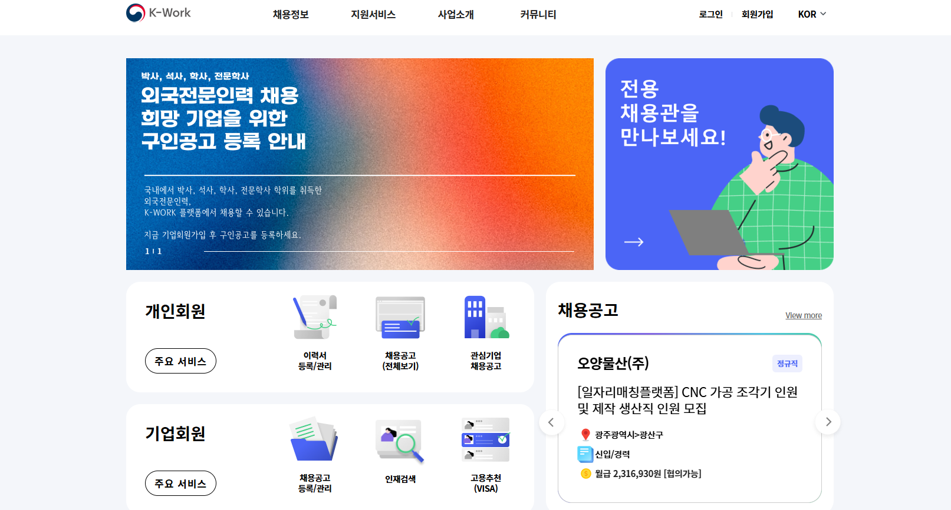
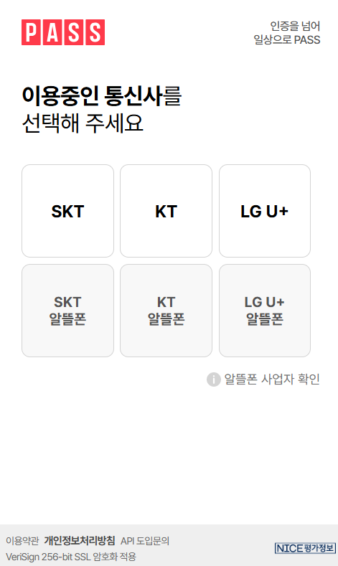
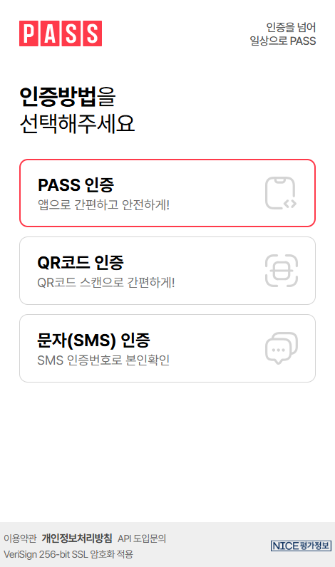
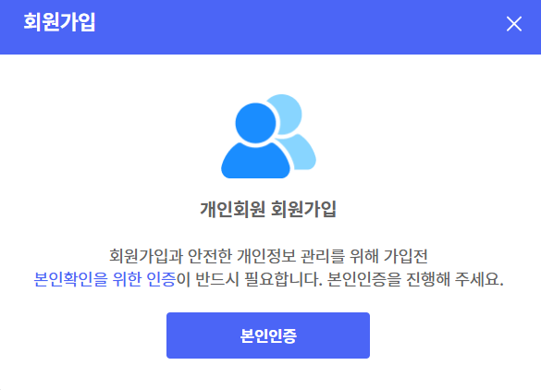
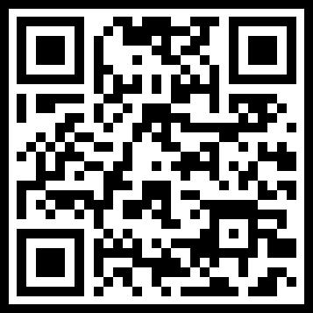
K-WORK User Guide
1
Register and log in
1
2
Register
Click [Sign up] and then click *Individual Membership Registration*
Click Identity Verification and proceed with mobile phone identity verification (mobile phone with your name is required)
Identity verification through PASS

Slide 16
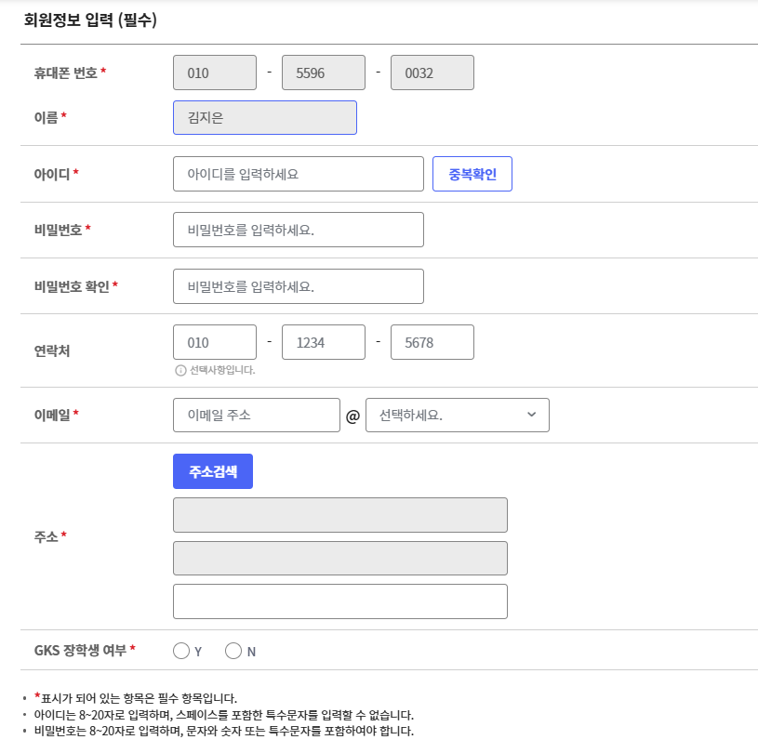
K-WORK User Guide
2
Enter member information_ Required basic information
The mobile phone number name entered during identity verification is automatically entered
ID input and duplicate check
Enter and confirm password (8~20 digits of numbers, letters, special characters (!@#) combination)
Enter your email address and address in Korea

Slide 17
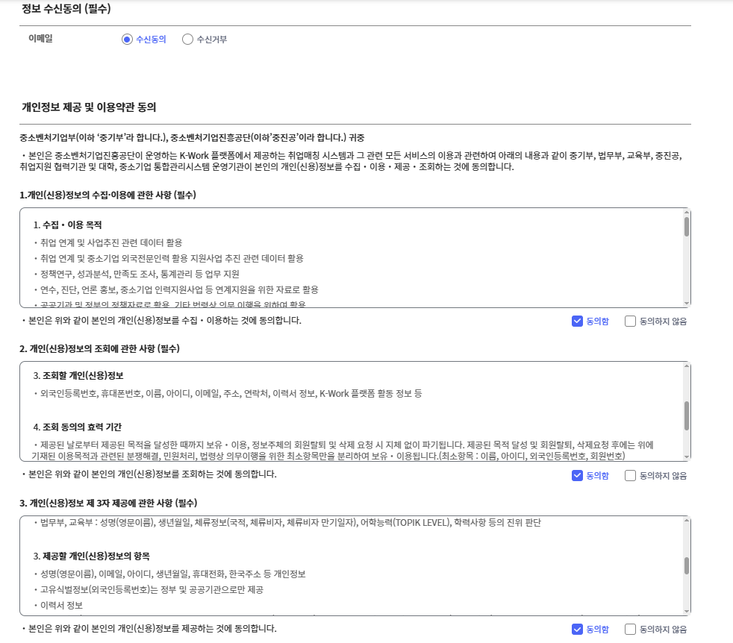
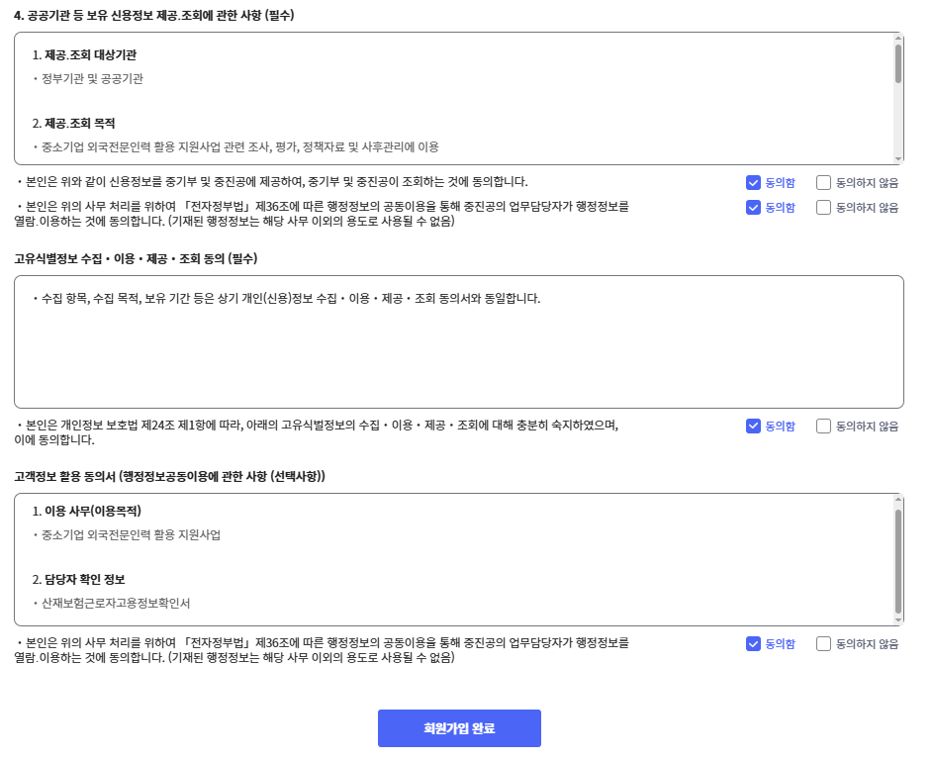
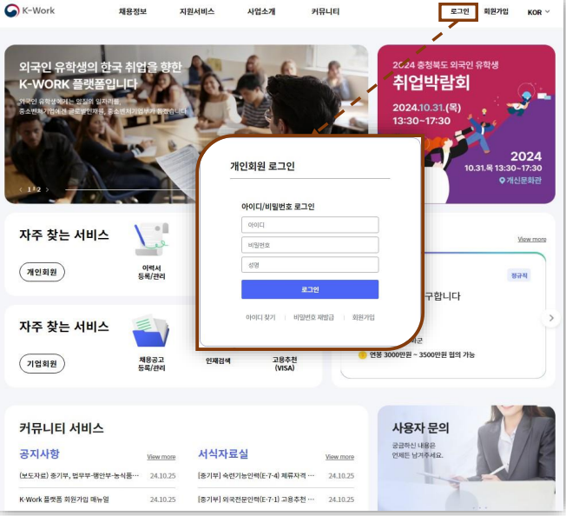
K-WORK User Guide
3
Register and log in
Enter member information_Consent to receive information,
provision of personal information, and agreement to terms of use
(1) Consent to receive information (required)
* Opt-in to receive emails
(2) Provision of personal information and agreement to terms of use {Required)
* Matters concerning the collection and use of personal (credit) information
* Matters concerning the inquiry of personal (credit) information
* Matters concerning the provision of personal (industrial) information to third parties
* Matters concerning the provision of credit information held by public institutions, etc.
(3) Click Complete Membership
3
login
(1) Place the cursor in the login at the top right and click Individual Member Login.
(2) Enter your ID/Secret Number/Name in the login window and click Log in.

Slide 18
Introduction to Woosong University
Employment Support Center
Employment
Support Center
Operation and Introduction

Slide 19
Introduction to Woosong University
Employment Support Center
Operation of Employment Support Center
By analyzing individual characteristics, middle. Systematically support and operate various programs to set a long-term career management plan
We support you to recognize the rapidly changing job market trend through 1:1 consulting on career goal setting, and support you to develop competitive employment competencies by filming and monitoring the interview process through mock interviews.
Providing various employment and job search information through the Soldream Plus website, operating a resource room where you can browse employment-related books and job information, and holding various job fairs
Career Support Center Step-by-Step Service
1. Career Counseling
2. Job Application Clinic
3. Interview Clinic
4. Job search strategy and follow-up management

Slide 20
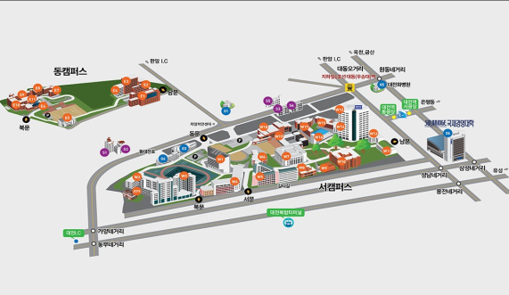
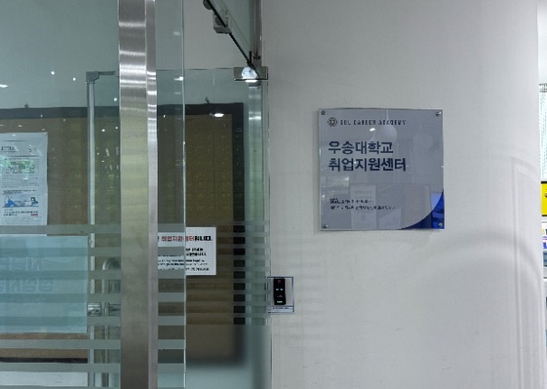
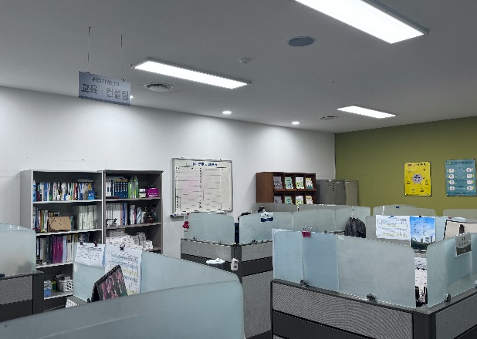
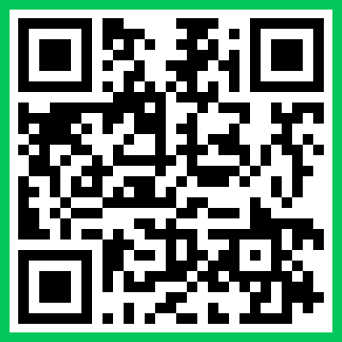
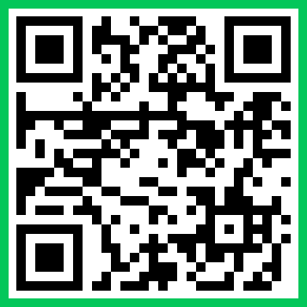
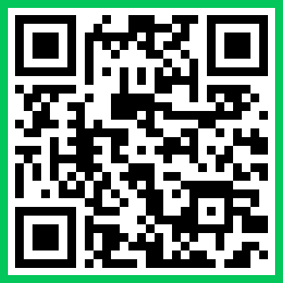
Location map of Woosung Global Employment Support Center
"Opening the door to your dream job in Korea — with Woosong."
Homepage
SolDream+
K-WORK
Woosong Global Employment Support Center
T. 042]630-9997 , 630-9680 F.042-630-9892 E-mail : career@wsu.ac.kr

